Slide 1

TERM DEPOSIT ANALYSIS AND PREDICTION
EDA, DATA PREPROCESSING AND COMPARING DIFFERENT MACHINE LEARNING MODELS FOR PREDICTING SUBSCRIPTION TO BANK TERM DEPOSIT.

Slide 2
TEAM MEMBERS:
UTKARSH MISHRA (11600119031)
PRATYUSH MAJUMDER (11600119046)
ROSHNI DEY (11600119033)
TANISHA GHOSH (11600119050)
TIYASHA PARUI (11600119028)
GROUP ~ 6
MENTOR ~ Ms. RACHITA GHOSHHAJRA
COORDINATOR ~ Mr. SUMIT MAJUMDAR

Slide 3
ACKNOWLEDGEMENT:
We would take the opportunity to express our deep sense of gratitude to Mr. Avijit Bose, Head of the Department, Computer Science and Engineering, MCKV Institute of Engineering for supporting us to make our project worth it.
We would want to convey our thanks to Ms. Rachita Ghoshhajra, our mentor, for guiding us through this process. We've learned a lot of new things thanks to her guidance, and we're looking forward to learning even more in the future.
The project coordinator, Mr. Sumit Majumdar, is also to be thanked for providing and delineating the administrative procedures pertaining to project processes.

Slide 4
BACKGROUND:
Machine learning is a broad term encompassing a number of methods that allow the investigator to learn from the data. These methods may permit large real-world databases to be more rapidly translated to applications to inform patient-provider decision making.
A wide variety of approaches, algorithms, statistical software, and validation strategies were employed in the application of machine learning methods to inform patient-provider decision making.
There is a need to ensure that multiple machine learning approaches are used, the model selection strategy is clearly defined, and both internal and external validation are necessary to be sure that decisions for patient care are being made with the highest quality evidence.
Our model will include Data preprocessing and Comparing different machine learning models for predicting subscription to bank term deposit.

Slide 5
INTRODUCTION:
A term deposit is a cash investment held at a financial institution. Your money is invested for an agreed rate of interest over a fixed amount of time, or term.
The bank has various outreach plans to sell term deposits to their customers such as email marketing, advertisements, telephonic marketing and digital marketing.
Telephonic marketing campaigns still remain one of the most effective way to reach out to people. However, they require huge investment as large call centers are hired to actually execute these campaigns.
Hence, it is crucial to identify the customers most likely to convert beforehand so that they can be specifically targeted via call.

Slide 6
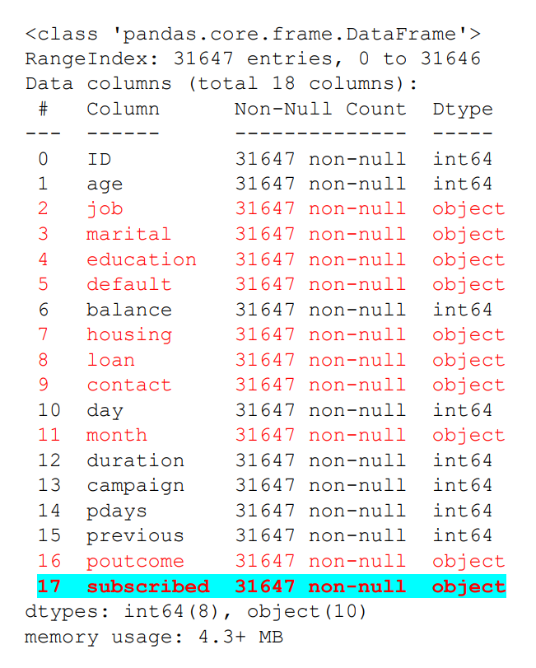
INTRODUCTION TO DATASET:
PROPERTY | DATASET 1 | DATASET 2
ENTRIES | 31647 | 45211
VARIABLES | 18 | 18
TARGET VARIABLE | subscribed | subscribed
INDEPENDENT VARIABLES | 17 | 17
DEPENDENT VARIABLE | 01 | 01
CONTINUOUS VARIABLES | 10 | 10
CATEGORICAL VARIABLES | 08 | 08
SHAPE | (31647,18) | (45211,18)

Slide 7
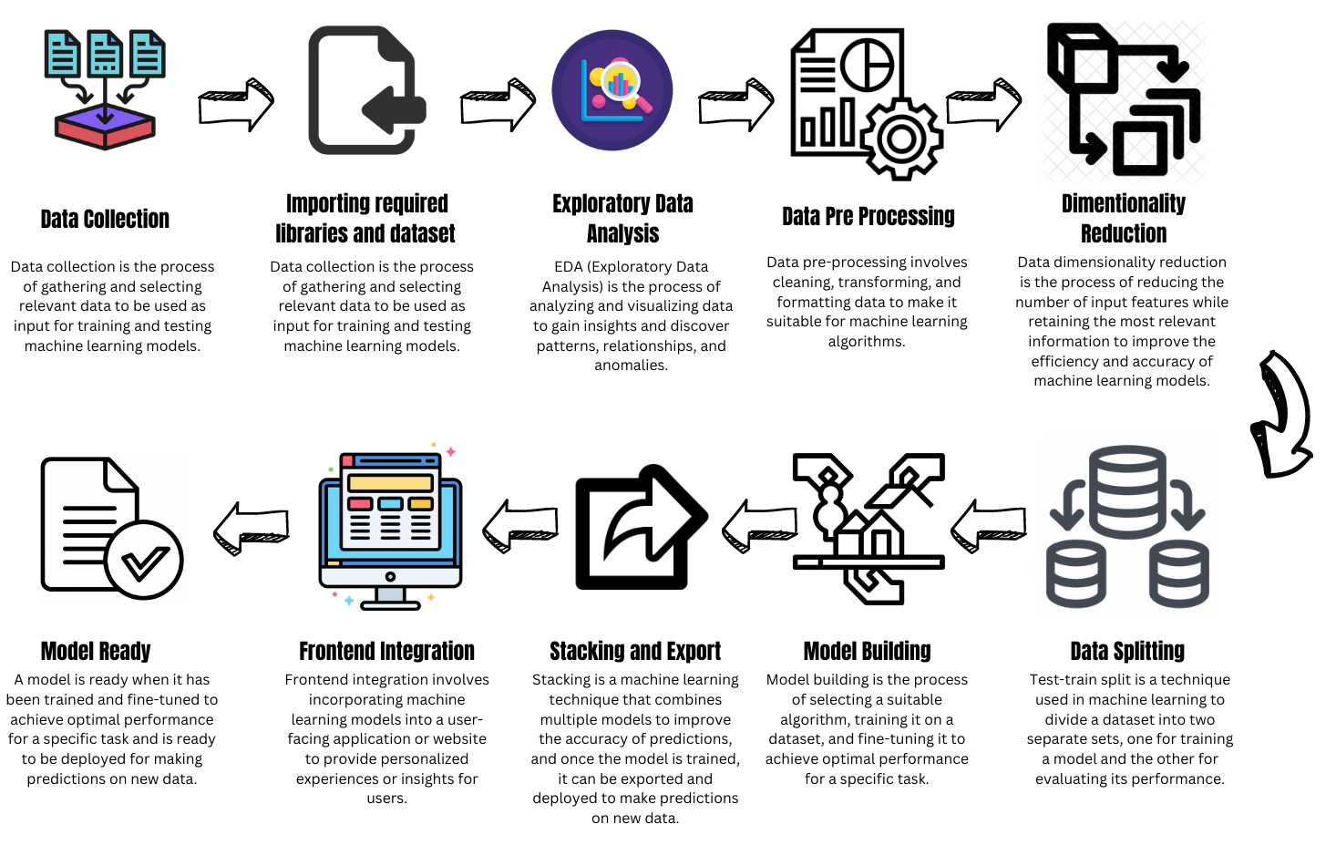
WORKFLOW MODEL:

Slide 8
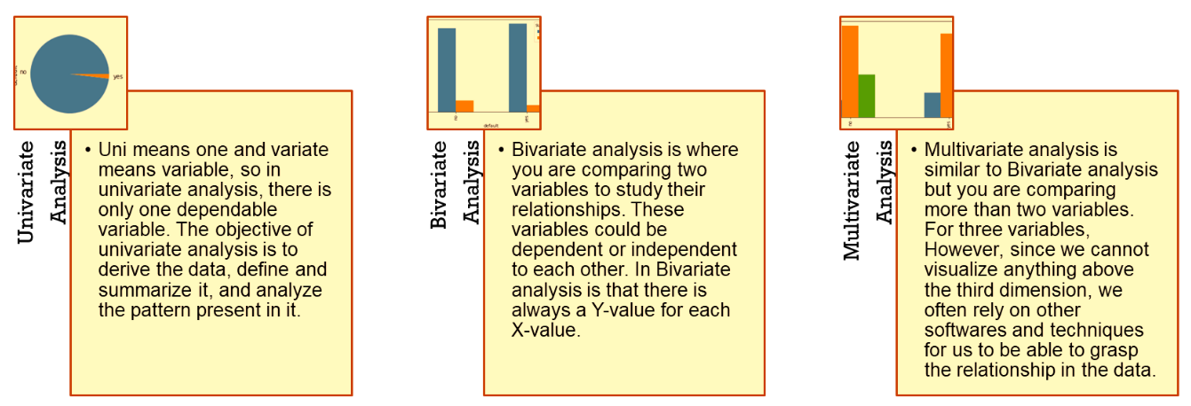
EXPLORATORY DATA ANALYSIS:
EDA stands for Exploratory Data Analysis and is a crucial step in data analysis.
It involves summarizing and visualizing data to identify patterns, relationships, and outliers.
EDA is an iterative process that helps analysts to better understand the data they are working with.
It can identify potential issues with the data, such as missing values or data entry errors.
It is an essential step in the data analysis process and can help analysts uncover valuable insights.

Slide 9
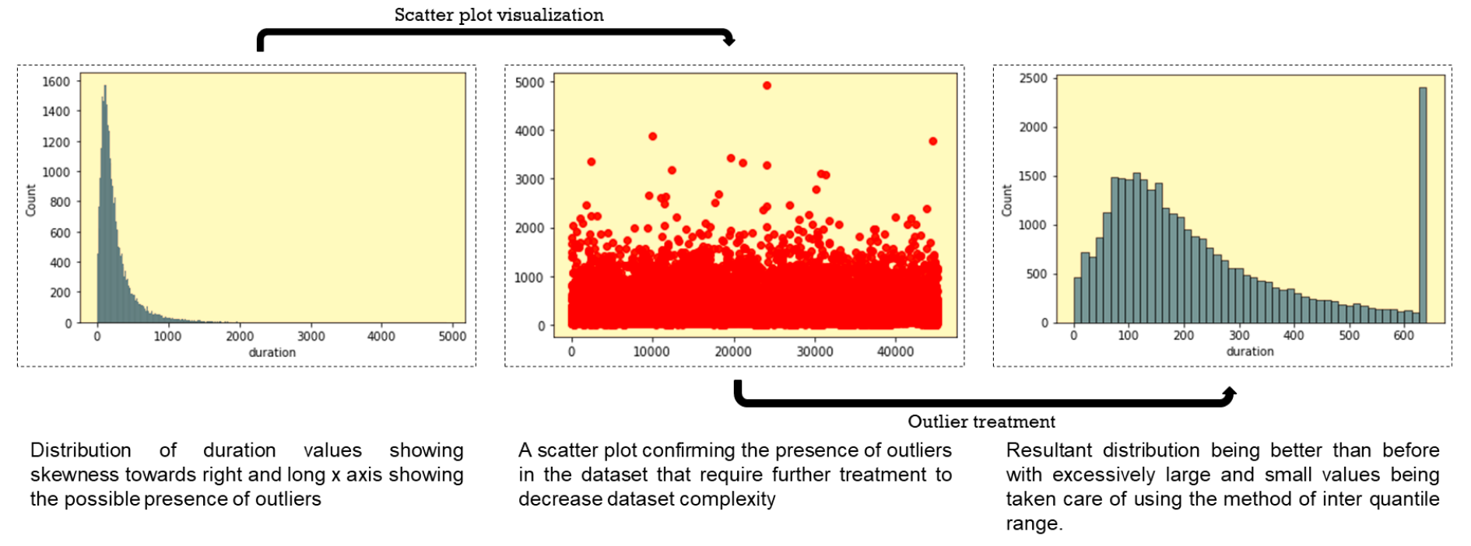
DURATION – EDA AND OUTLIER TREATMENT:

Slide 10
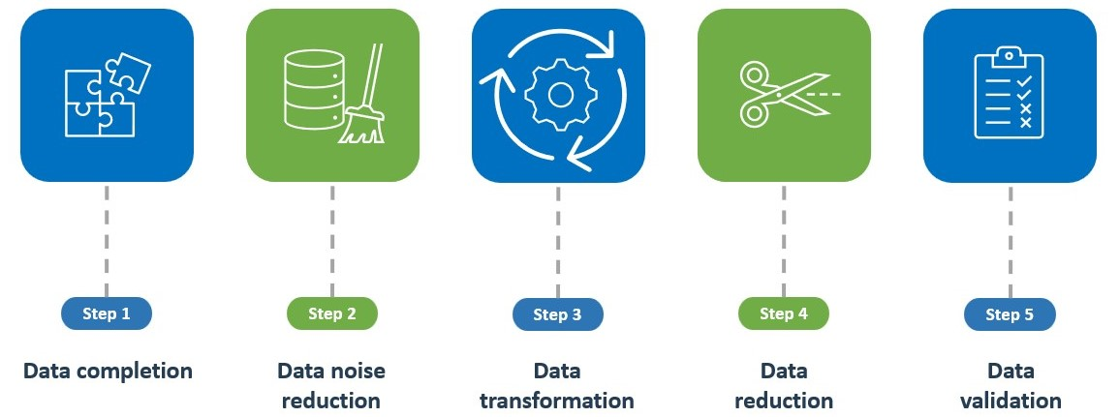
DATA PRE-POCESSING:
Data preprocessing is a process of preparing the raw data and making it suitable for a machine learning model. It is the first and crucial step while creating a machine learning model.
Why do we need Data Preprocessing?
Data preprocessing is required tasks for cleaning the data and making it suitable for a machine learning model which also increases the accuracy and efficiency of a machine learning model
Steps involved in data pre-processing are as follows:

Slide 11
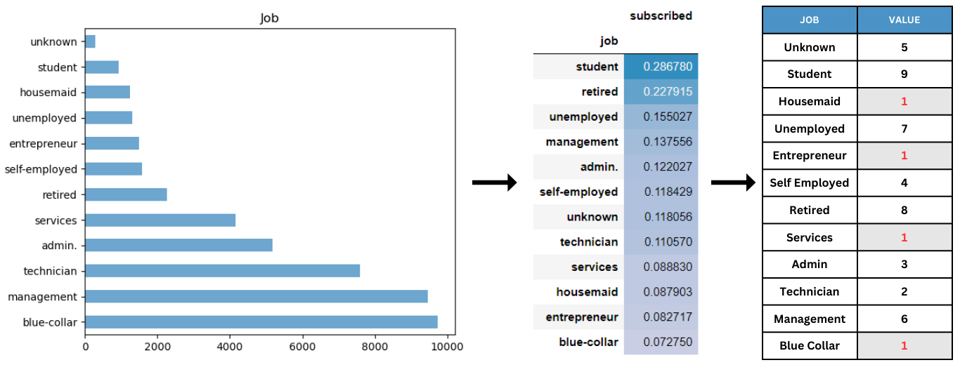
CATEGORICAL VARIABLE CONVERSION:
Extensive data processing can be a difficult and time-consuming operation that calls for specialized knowledge and software solutions. However, the understanding that can be attained from delving into vast amounts of data can result in appreciable improvements in organizational performance, effectiveness, and decision-making
It can also be observed that certain jobs like entrepreneur, blue-collar, services and housemaid share same percentage of subscribed individuals and it is way more less when compared with jobs of other categories. Hence, they can be grouped together while converting them into category based numeric form for them to be categorized as a single entity of job

Slide 12
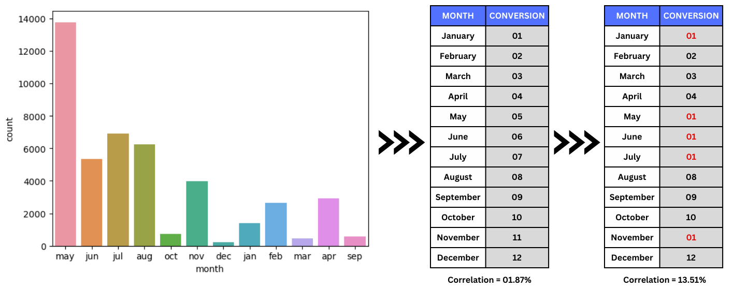
CATEGORICAL VARIABLE CONVERSION:
Similar to the type of conversion performed for job, it can be said that certain months, including May, June, July, January, and November, share a similar percentage of individuals who have subscribed, and this percentage is significantly lower than that of other job categories.
Therefore, these months can be grouped together and converted into a category-based numeric form to be categorized as a single job entity. The correlation before and after grouping and numerical transformation was 2% and 13.5%, respectively.

Slide 13
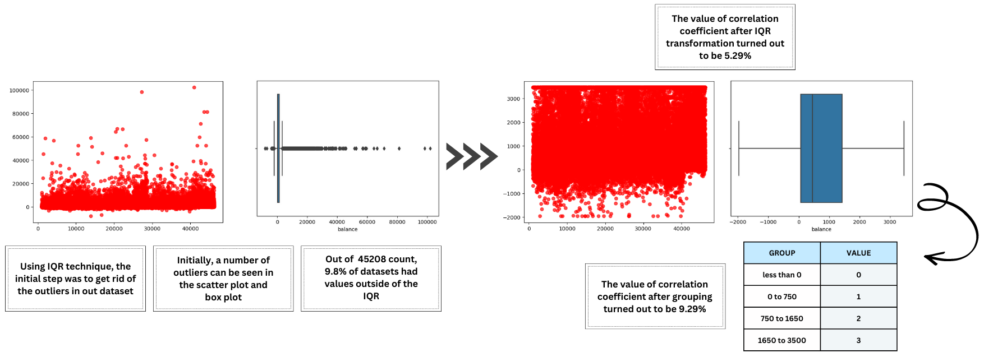
CONTINUOUS VARIABLE CONVERSION:
The variable "balance" is a numerical variable that can be used for modeling purposes, but its complexity can be reduced by removing outliers or grouping the data into bands. At first, "balance" had a correlation value of 0.05283 (or 5%) with the target variable.
However, after applying outlier removal and grouping the data into groups of four, the correlation value increased considerably to 0.09617 (or approximately 10%).

Slide 14
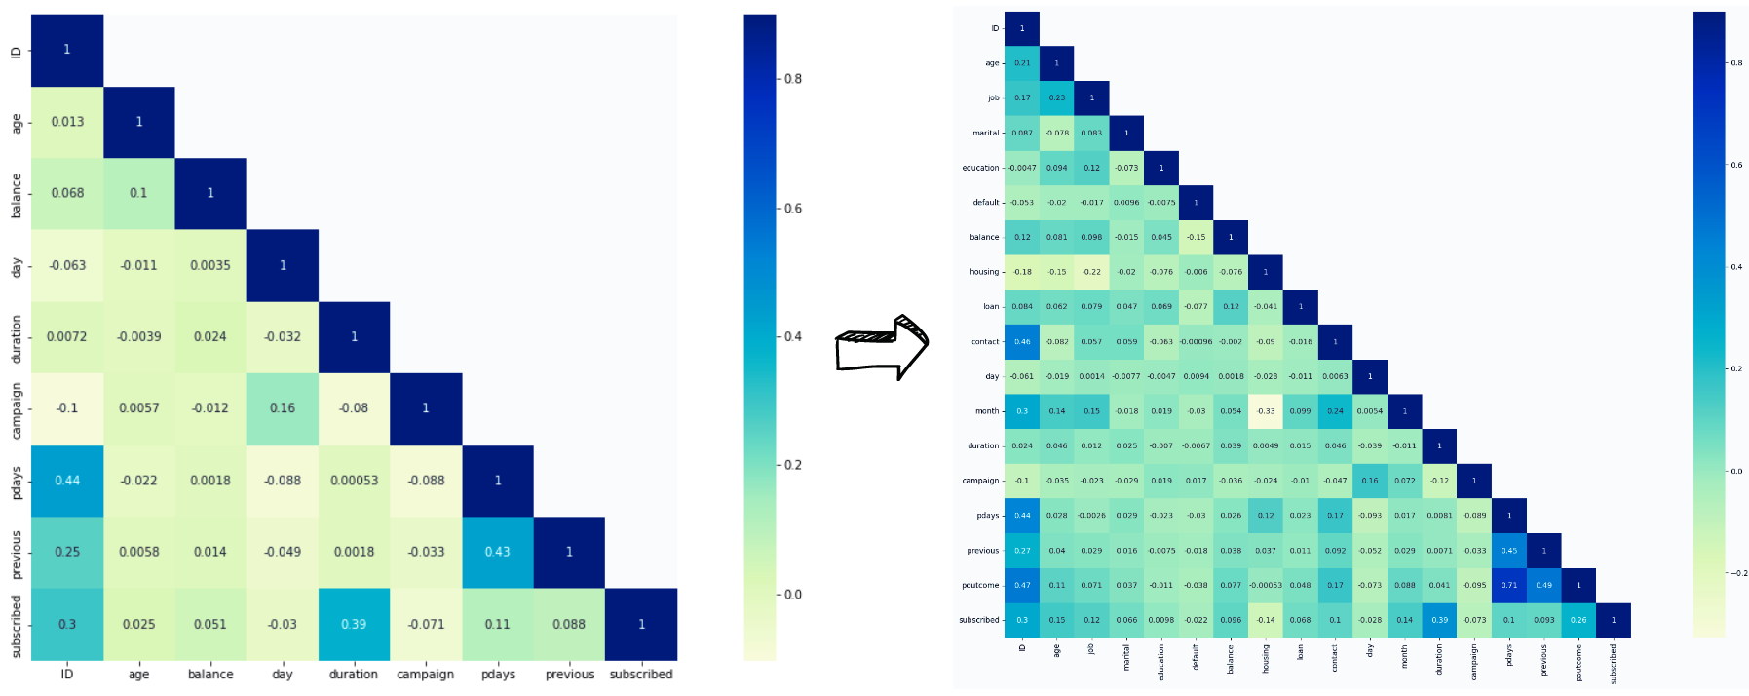
UPGRADED CORRELATION HEATMAP:

Slide 15
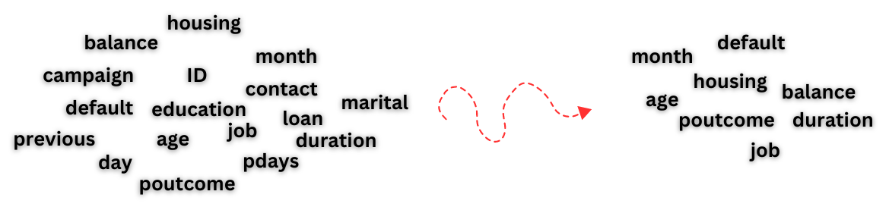
FEATURE SELECTION:
Feature selection is the process of selecting a subset of relevant features from a larger set of features in a dataset.
The goal of feature selection is to improve the performance of a model by reducing the dimensionality of the input space and removing irrelevant or redundant features.
Feature selection can improve model accuracy, reduce overfitting, and speed up training times. It is a critical step in machine learning and can help improve model performance and efficiency.
In our model, we utilized backward elimination as a method to remove variables that displayed multicollinearity, had a low correlation coefficient, and were deemed unimportant for the process of constructing the model.

Slide 16
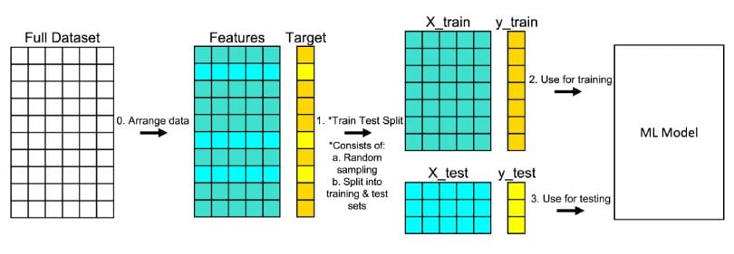
TEST TRAIN SPLIT:
The train-test split procedure is used to estimate the performance of machine learning algorithms when they are used to make predictions on data not used to train the model.
If your training accuracy is high, but your testing accuracy is low, you can’t really advertise your model as a good model.
Cross-validation is a resampling method that tests and trains a model on different iterations using different chunks of the data.

Slide 17
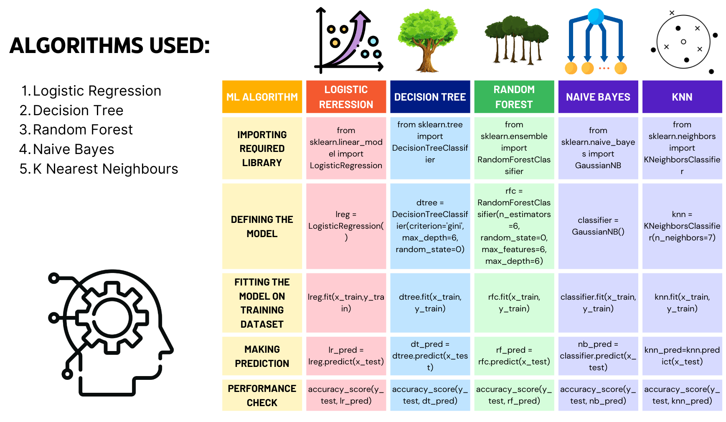
IMPLEMENTATION:

Slide 18
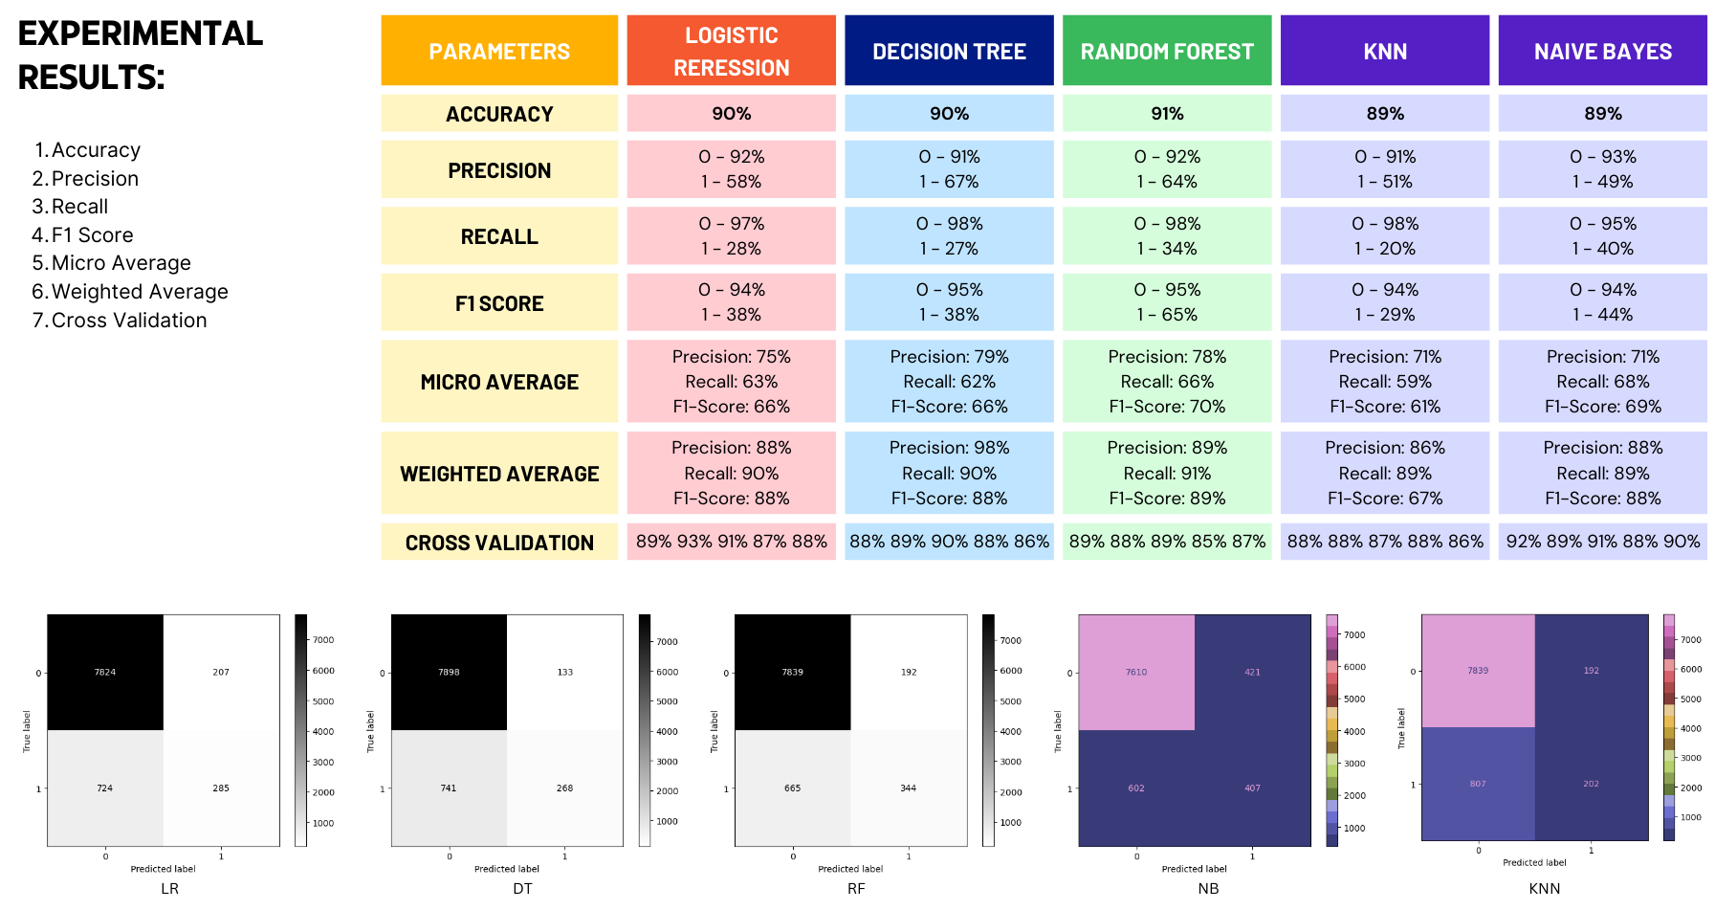
FINAL RESULTs:

Slide 19
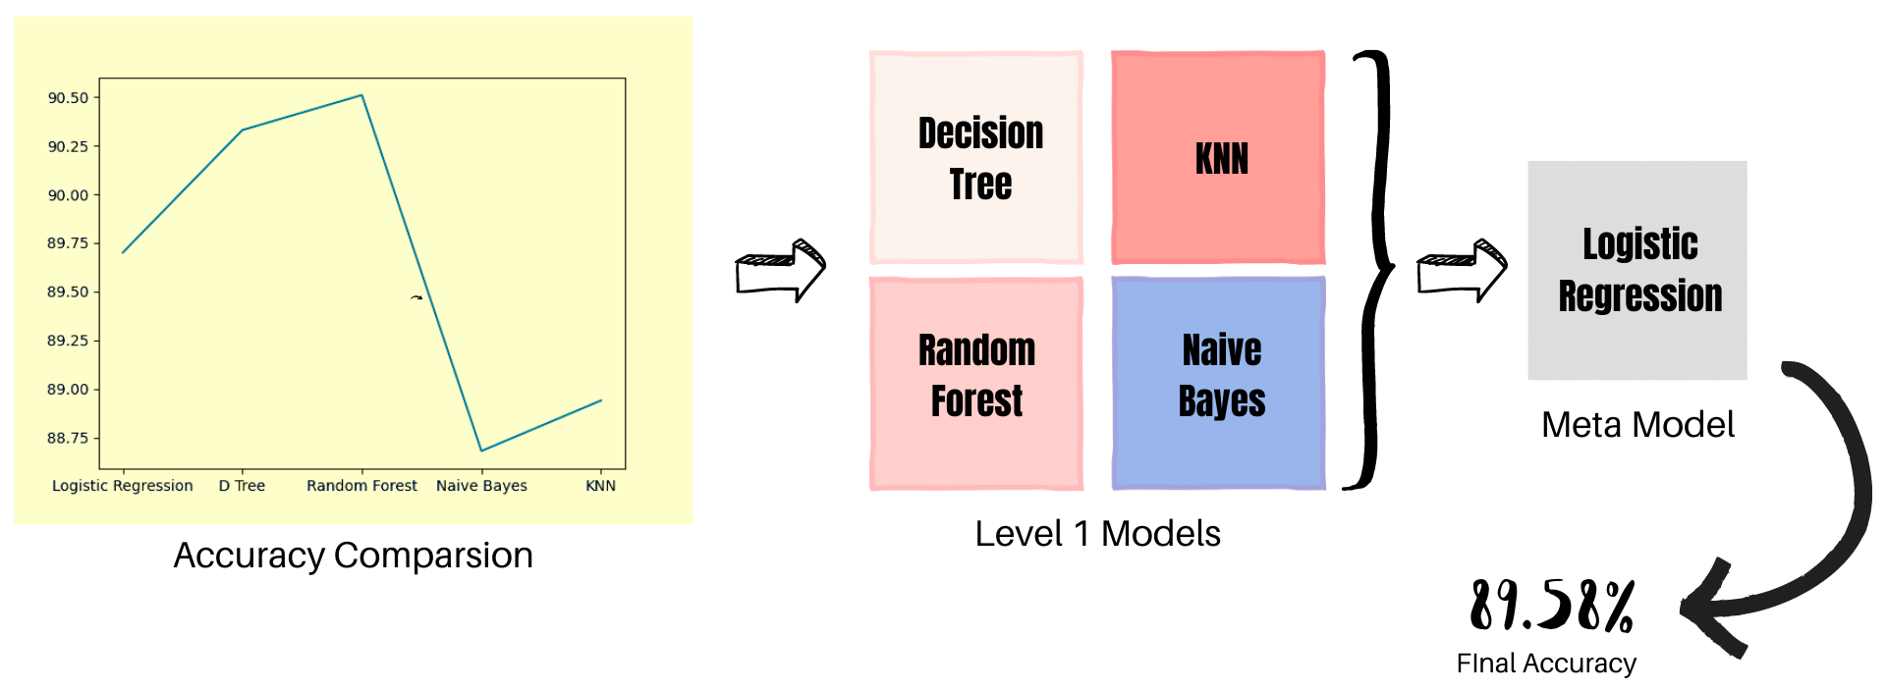
STACKING:
Stacking, also known as stacked generalization, is a meta-learning ensemble technique that involves combining multiple models to improve prediction accuracy.
In stacking, the outputs of several base models are used as input features to a higher-level "meta-model", which makes the final predictions. The base models can be trained on the same or different datasets and can use different learning algorithms.
"By achieving approximately 90% accuracy across different models, we can infer that we have significantly simplified our dataset and successfully conducted thorough data cleaning processes."

Slide 20
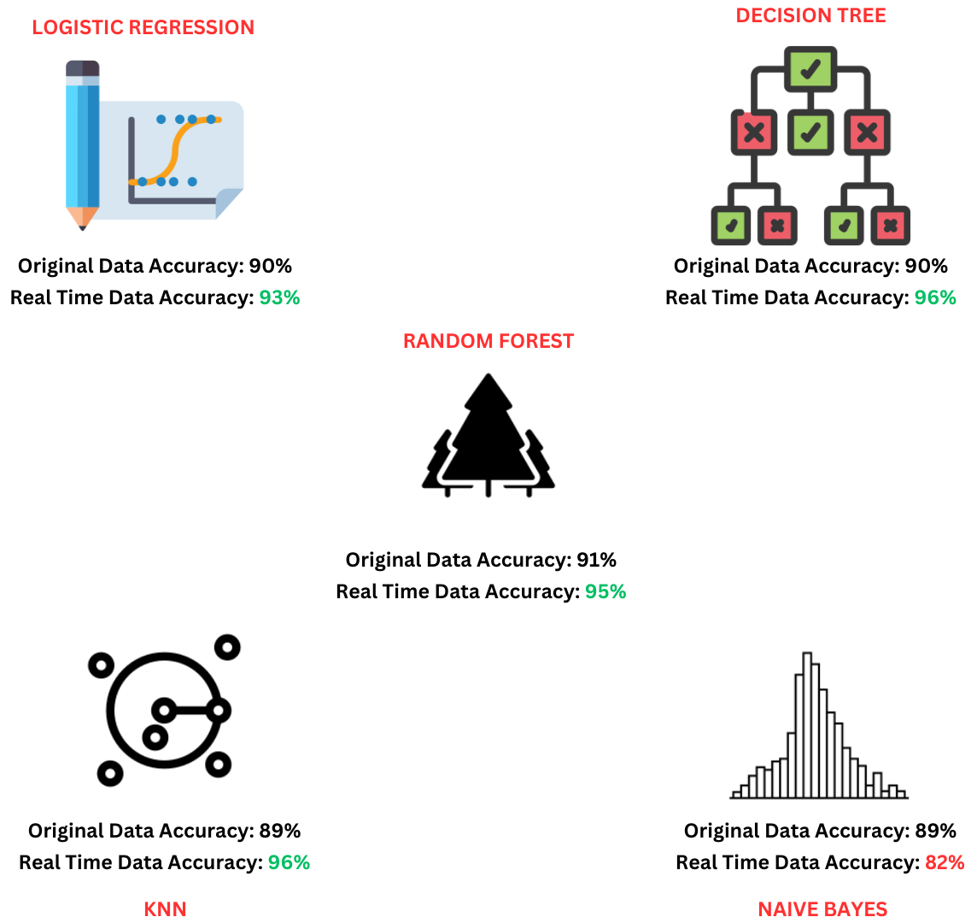
WORKING ON REAL TIME DATASET:
We have gathered over 450 real-time data entries from various individuals. Subsequently, we applied exploratory data analysis (EDA) and data pre-processing techniques to transform the dataset. Finally, we utilized the processed dataset to evaluate our model, leading to the following observations:

Slide 21
CONCLUSION:
In this entire money exchange process and banks undergoing digitalization, our work will assist banks in determining the clients who are most likely to opt for a term deposit plan, allowing banking institutions to save a significant amount of spending.
For our initial dataset, accuracy of random forest turned out to be the best (91%), followed by Naïve Bayes with the highest precision value (94%) whereas identifying the actual positives that our model correctly predicted was shown by random forest with the highest recall value (98%).
Real time dataset showed better results and accuracy when used for testing.

Slide 22
FUTURE SCOPE:
Model Improvement
Scalability and Development with larger datasets
Continuous learning and adaptation
Integration with other technologies

Slide 23
REFERNECES:
[1] S. Manlangit, S. Azam, B. Shanmugam and A. Karim,” Novel Machine Learning Approach for Analysing Anonymous Credit Card Fraud Patterns”, International Journal of Electronic Commerce Studies 10.2 (2019): 175-202
M. Sergio, L. Raul and C. Paulo,” Using data mining for bank direct marketing: an application of the CRISP-DM methodology”, RepositoriUM, 2011
C. S. T. Koumetio, W. Cherif and S. Hassan,” Optimizing the prediction of telemarketing target calls by a classification technique,” 2018 6th International Conference on Wireless Networks and Mobile Communications (WINCOM), 2018
J. Asare-Frempong and M. Jaya Balan,” Predicting customer response to bank direct telemarketing campaign,” 2017 International Conference on Engineering Technology and Technopreneur ship (ICE2T), 2017

Slide 24
REFERNECES:
Rony MA, Hassan MM, Ahmed E, Karim A, Azam S, Reza DA. Identifying Long-Term Deposit Customers: A Machine Learning Approach. In2021 2nd International Informatics and Software Engineering Conference (IISEC) 2021 Dec 16 (pp. 1-6). IEEE.
Bisong E. Matplotlib and seaborn. InBuilding machine learning and deep learning models on google cloud platform 2019 (pp. 151-165). Apress, Berkeley, CA.
Pedregosa F, Varoquaux G, Gramfort A, Michel V, Thirion B, Grisel O, Blondel M, Prettenhofer P, Weiss R, Dubourg V, Vanderplas J. Scikit-learn: Machine learning in Python. the Journal of machine Learning research. 2011 Nov 1;12:2825-30.
Song YY, Ying LU. Decision tree methods: applications for classification and prediction. Shanghai archives of psychiatry. 2015 Apr 4;27(2):130.

Slide 25
REFERNECES:
A. Gupta, A. Raghav and S. Srivastava,” Comparative Study of Machine Learning Algorithms for Portuguese Bank Data,” 2021 International Conference on Computing, Communication, and Intelligent Systems (ICCCIS), 2021.
G. Sell and D. Garcia-Romero,” Diarization resegmentation in the factor analysis subspace,” 2015 IEEE International Conference on Acoustics, Speech and Signal Processing (ICASSP), 2015, pp. 4794-4798
A. Sarmento, K. Yeo, S. Azam, A. Karim, A. Al Mamun and B. Shanmugam,” Applying Big Data Analytics in DDos Forensics: Challenges and Opportunities”, Cybersecurity, Privacy and Freedom Protection in the Connected World, pp. 235-252, 2021.

Slide 26
THANK YOU

